Slide 1
Data Visualization Views & Reports

Slide 2
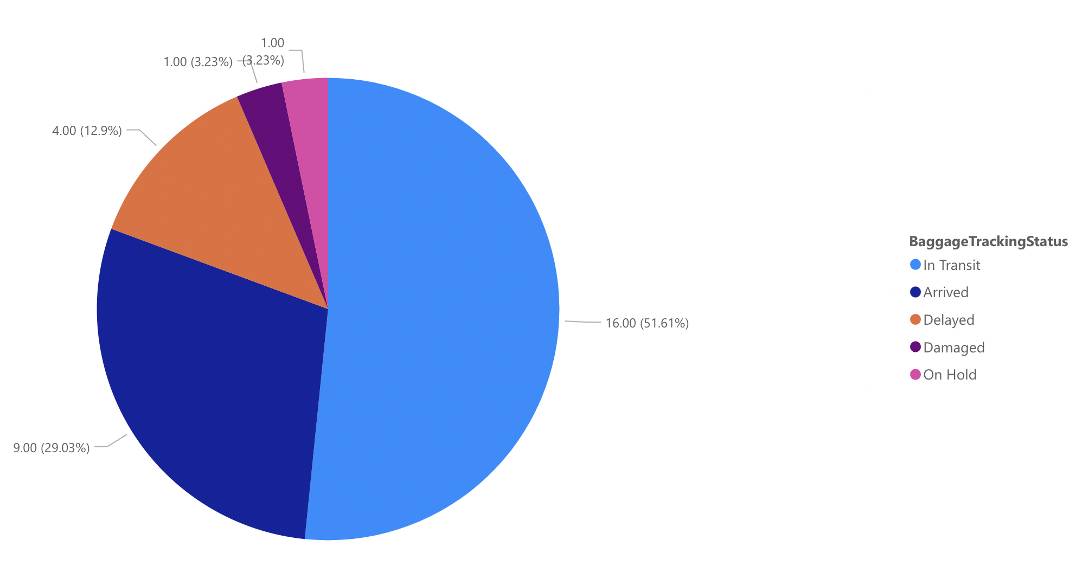
Count of Baggage with Different Tracking Status

Slide 3
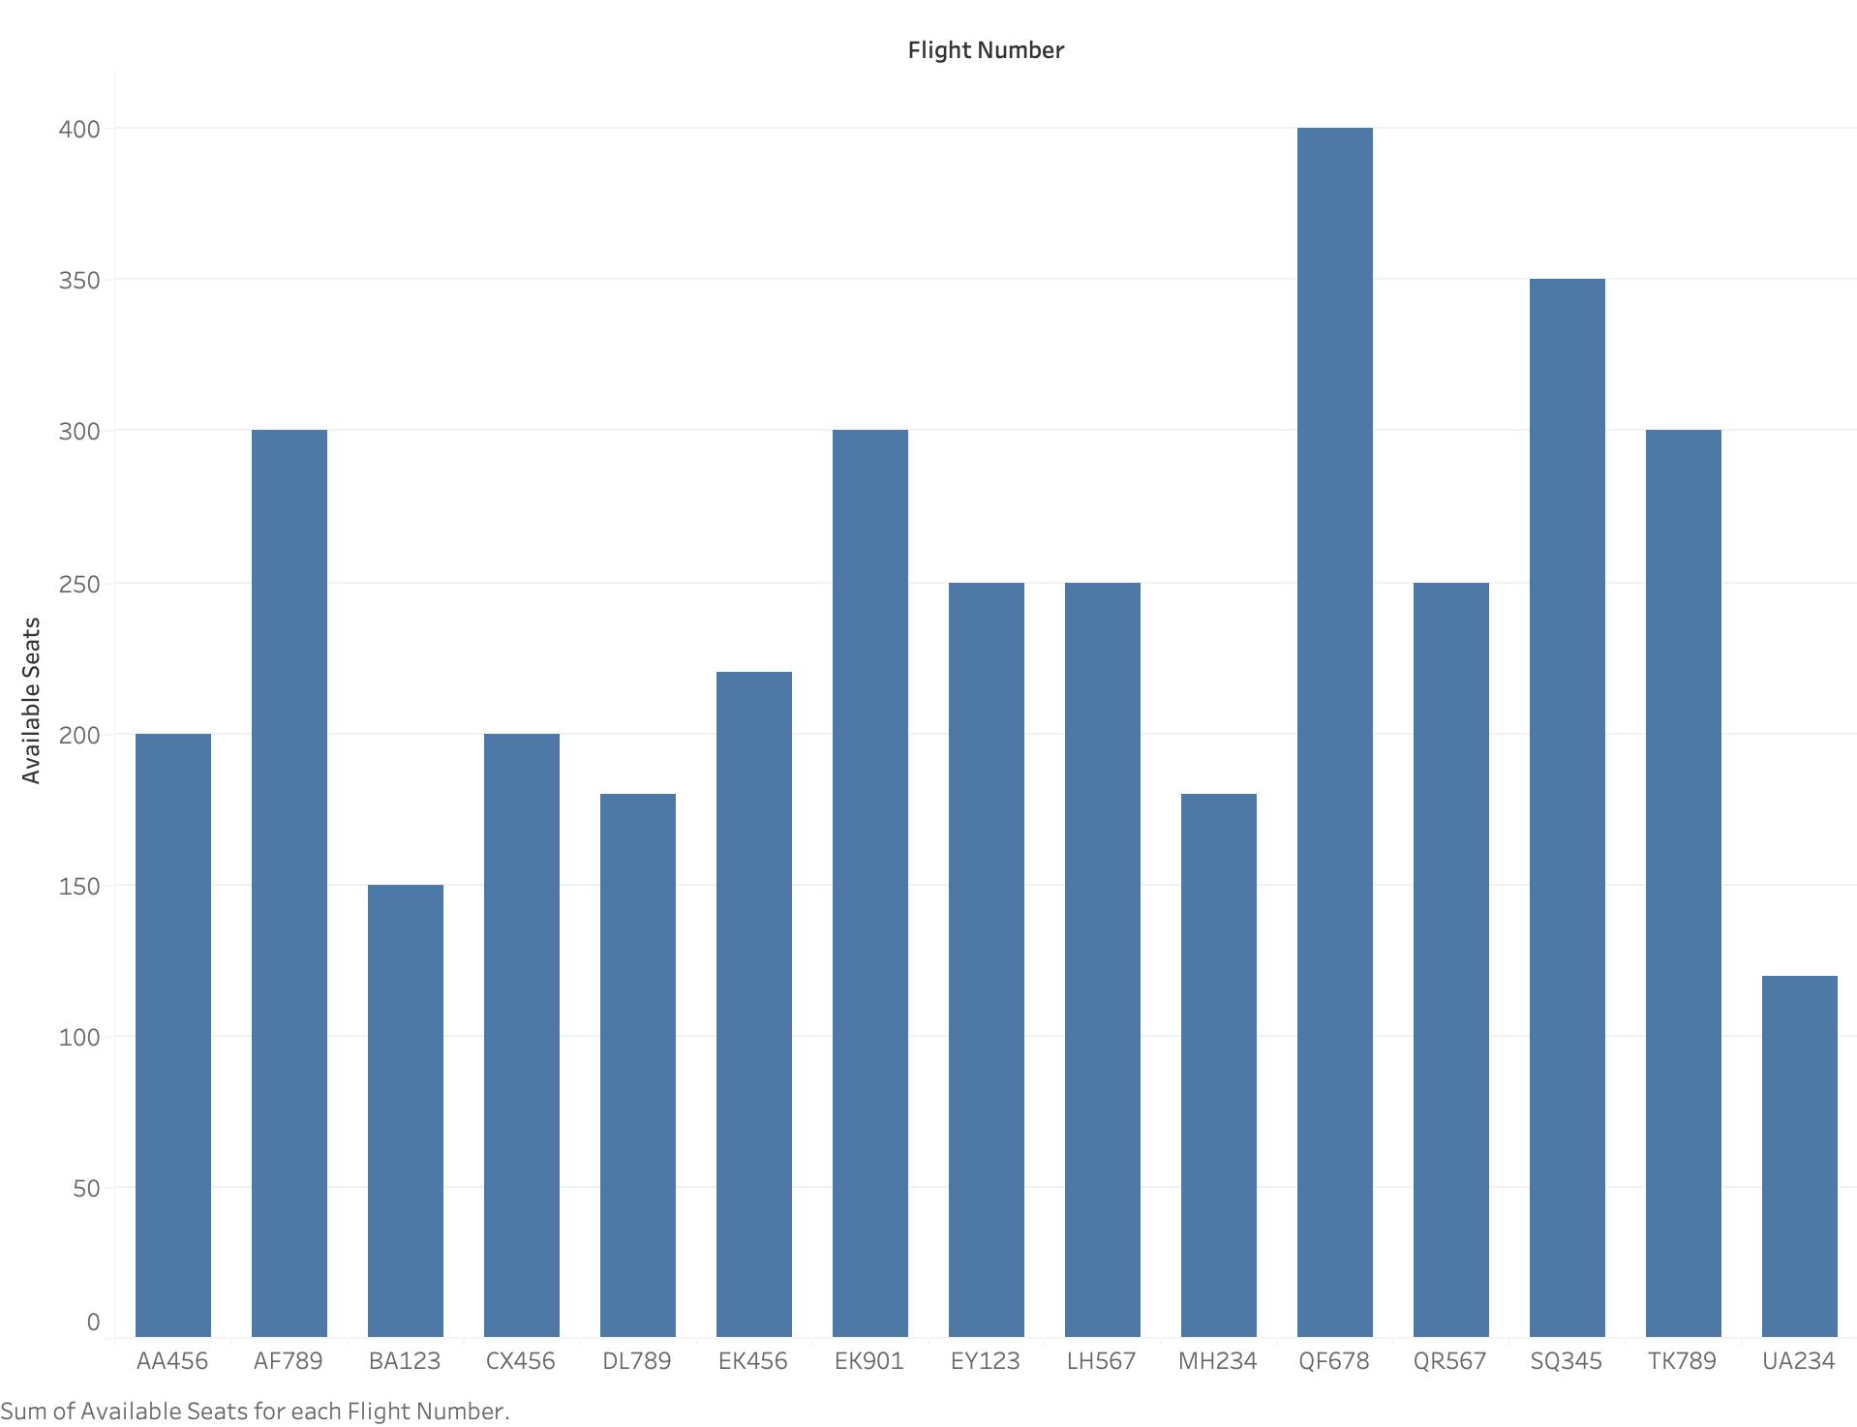
Visualization - Number of Available Seats for Each Flight

Slide 4
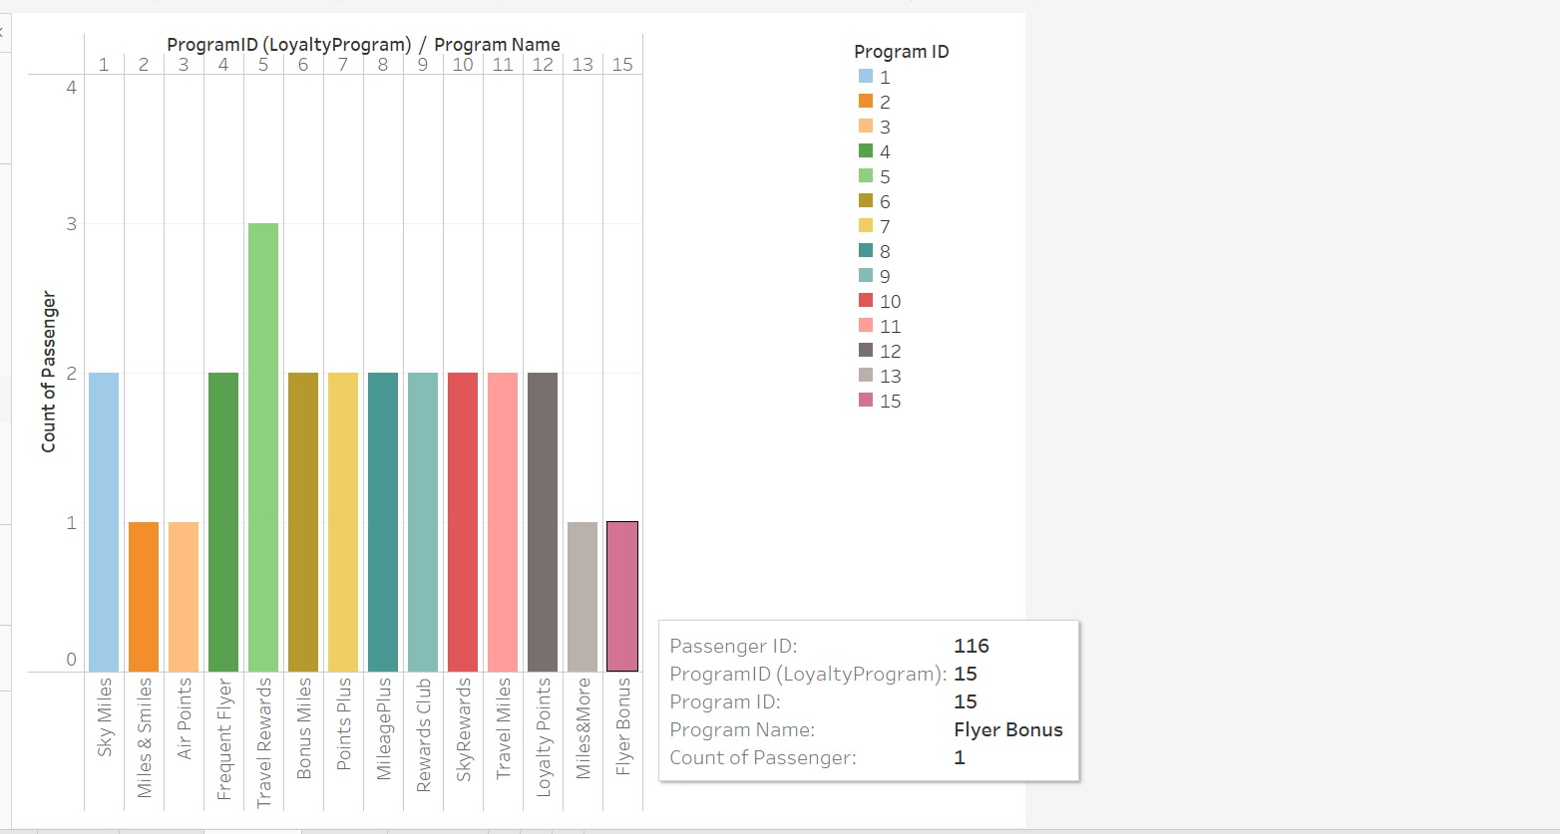
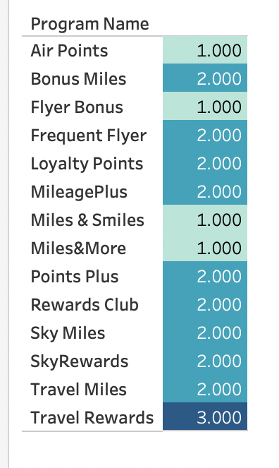
Loyalty Program Analysis -Distribution of passengers among different loyalty programs.

Slide 5
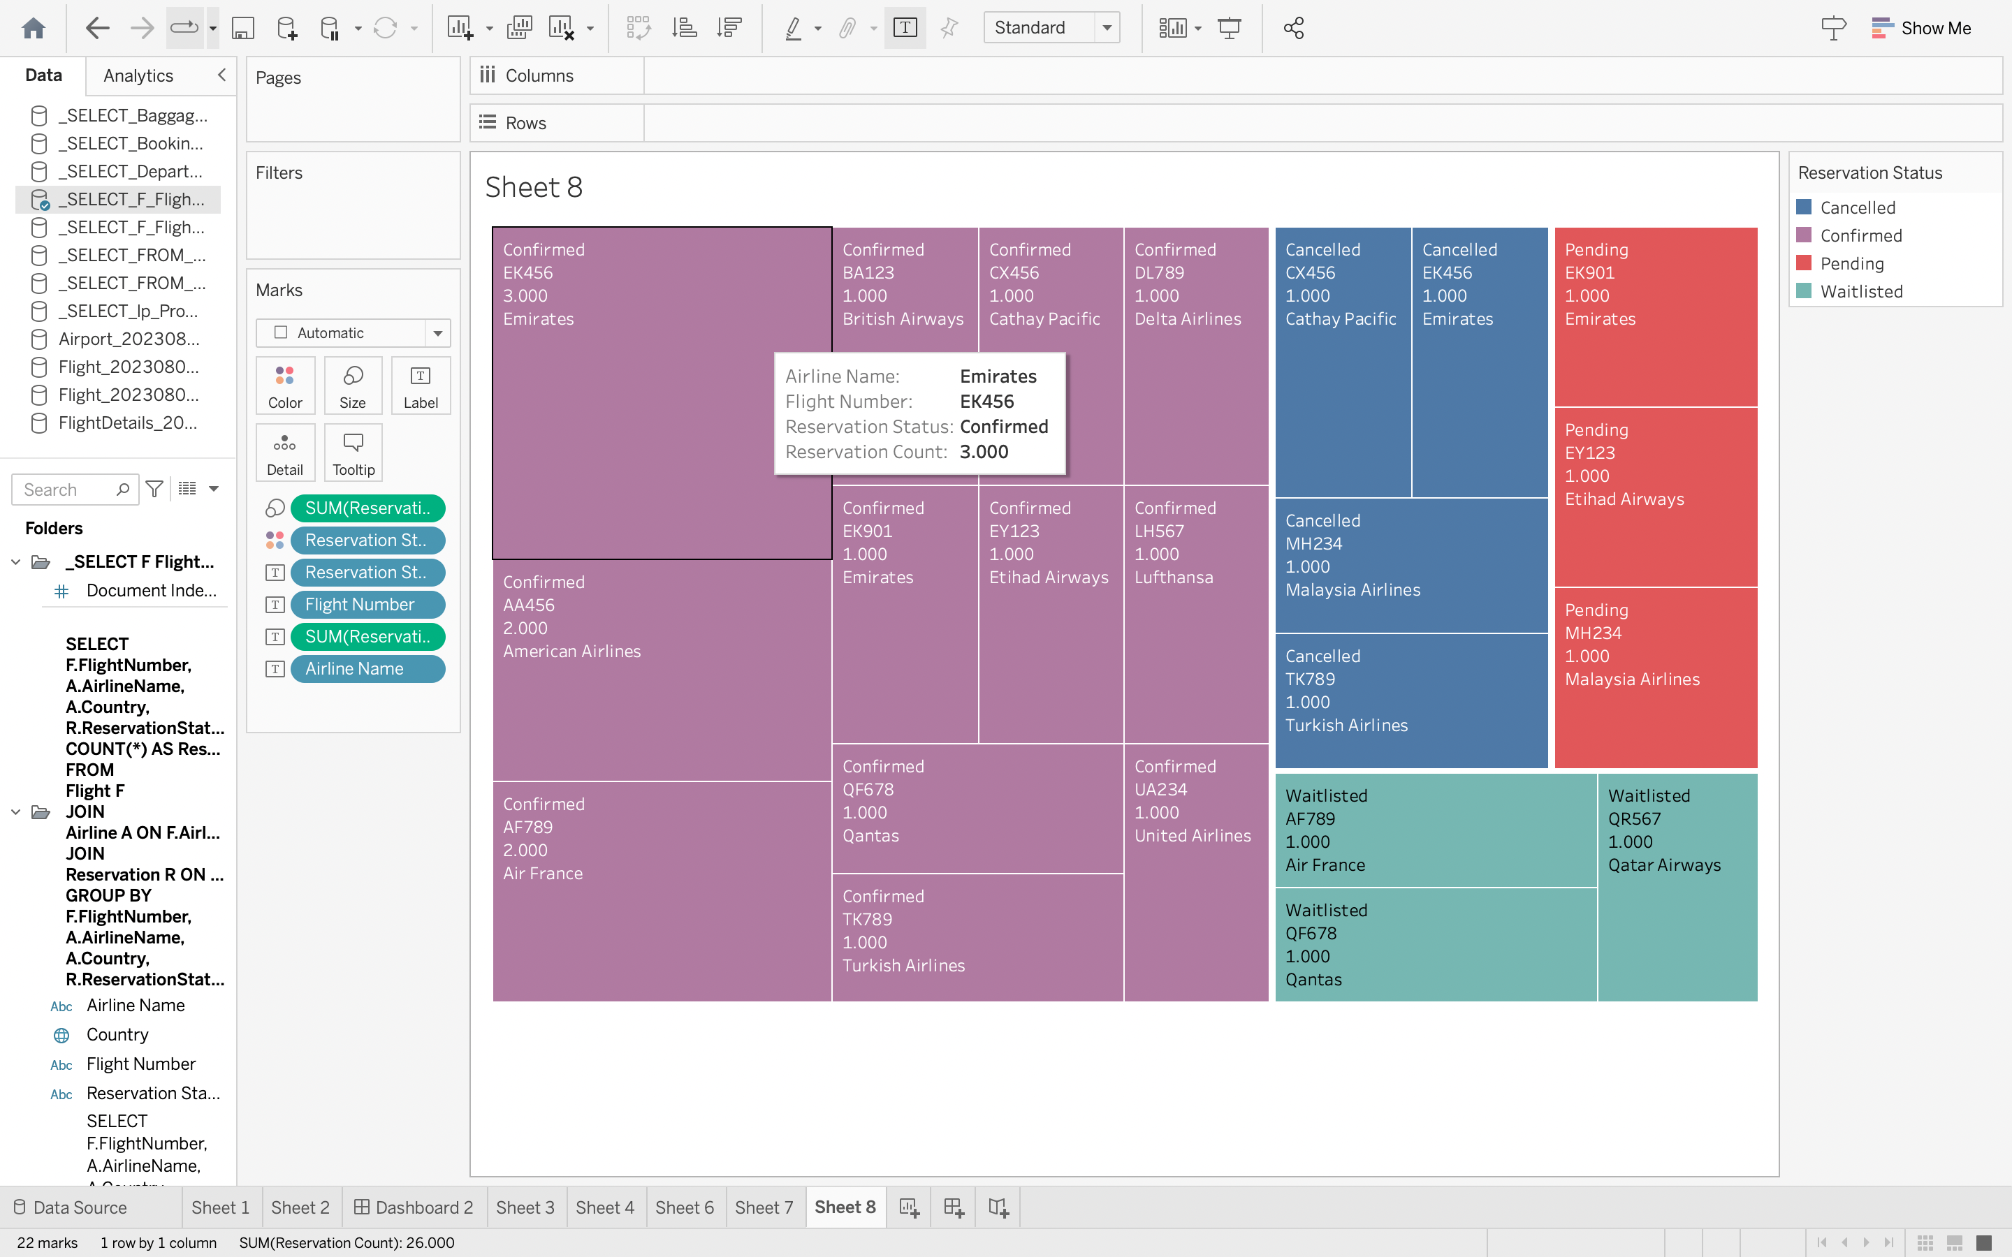
Flight-wise Reservation Status

Slide 6
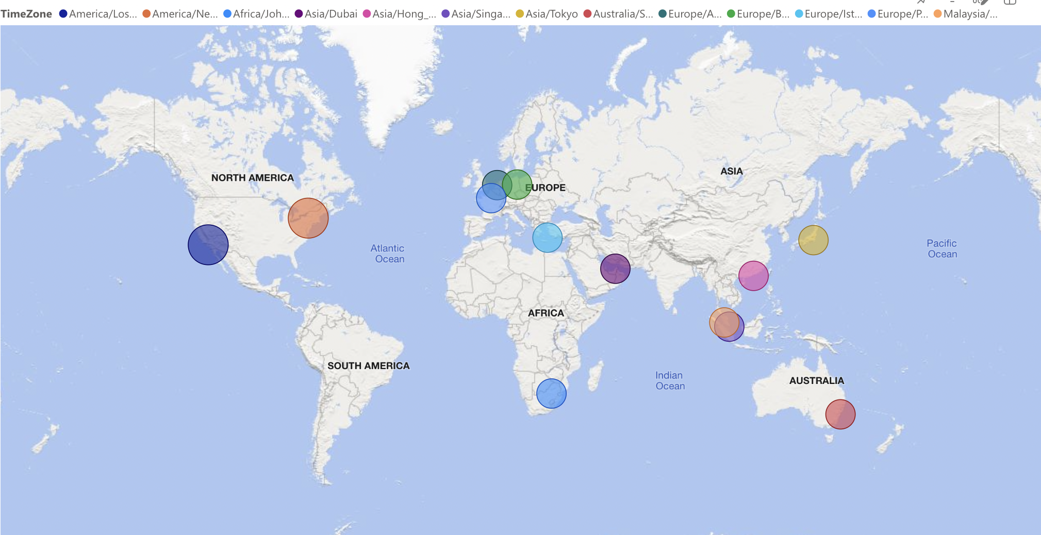
Airport Distribution by Time Zone

Slide 7
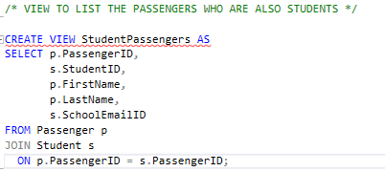
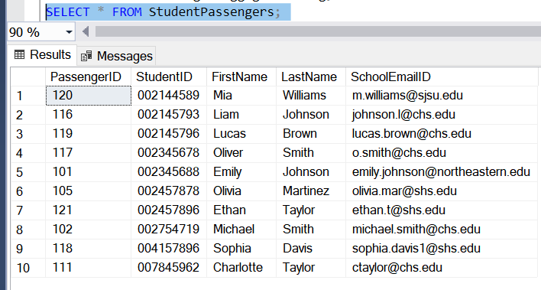
VIEW 1 – List of Student Passengers

Slide 8
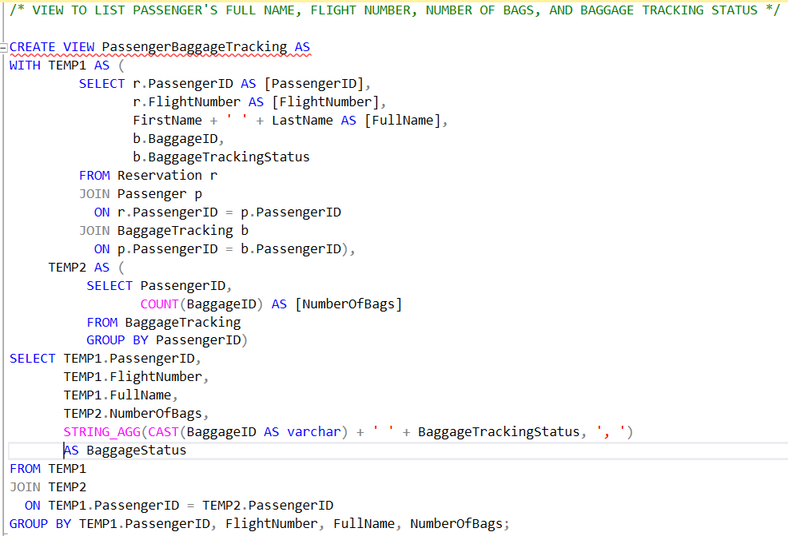
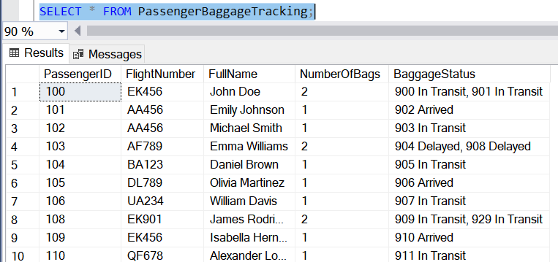
VIEW 2 – Passenger Baggage Tracking

Slide 9
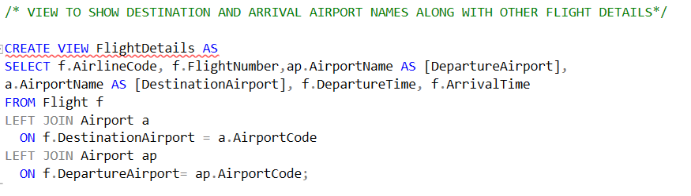
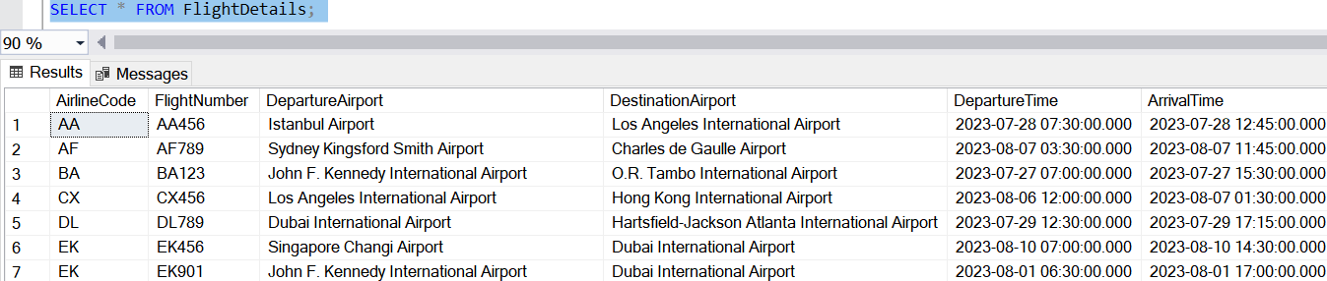
VIEW 3 – Flight Details

